Slide 1

The Trillion Dollar Problem For Tomorrow: Use of Web Scraping to Explore Return of Investment of Higher Education
Jon HarriS

Slide 2
Background
As of 2019, 45mill borrowers owe $1.5T in federal student loan debt [1]
College tuition is at an all-time high[2]
2018 avg. yearly tuition: Public, $21.4k; Private, $48.5k
1988 adj. avg. yearly tuition: Public, $9.4k; Private, $24.8k
Fun Fact: avg. hourly salary of post-Bachelor grads has increased 2.3% since 1989 [3]
University of California recently proposed a 5yr 2.8% annual increase [4]
Top 50 universities have increased tuition by 3.6% [5]
Tuition hike largely attributed to loss in state funding [6]
2018: -13% across all states
AL, AZ, LA, MS, OK, and PA down between 30-60%

Slide 3
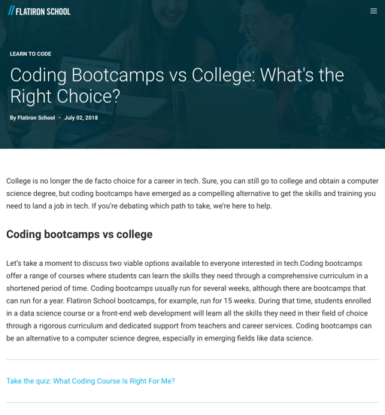
Changing Educational Landscape
Rising tuition costs changing how we view college
No longer for exploration/expanding one’s mind
Forced pragmatism; college now considered an investment
Mounting costs have led to new industries proposing alternatives to a 4yr college experience
Coding boot camps
Associate degrees
Job-specific apprenticeship programs
HS grads must weight many decisions
Public schools
Private schools
College major
Financial aid
Figure. Actual Flatiron School article [7]

Slide 4
Online Resources For Decision Making
Payscale.com
Public-facing Research Center
Education and salary data collected from 3.5 million civilian employees
Provides in-depth college and career-specific analytic reports for paying members
Available data is stratified across each major, college, career field, and job
Free data is available to the public
Includes general average salary and estimated return on investment data across universities and broadly defined college major types

Slide 5
Purpose
Broadly inspired by my own nomadic college experience
Texas Tech → Drexel University → UPenn
To explore how decisions made by a HS senior affect the return on investment of higher education
Type of degree
Type of college
College major
Regionality
Hypothesis
Bachelors degree maximizes earning potential compared to a 2yr Associates program
Return on investment higher for 4yr private universities compared to public schools (but may be regional)
Return on investment are dissimilar between majors

Slide 6
Web Scraping Methodology
Websites used: 2018 College Salary Report
Early- and Mid-career salary by state [8]
Estimated ROI by state [9]
Estimated ROI by major [10]
Web Scraping Tools:
Python/Selenium
Jupyter Notebook
Visualization Packages:
Seaborn
Matplotlib
Plotly
Analytical Packages:
Scipy
Pearson correlation, independent T-Test, One way Independent ANOVA
Statsmodels
Tukey’s post hoc analyses
Cumulative variables scraped from websites:
College name
College type
Private
Public (in state, out of state)
Service academy
Early career salary
Median salary of alumni (0-5yrs)
Mid-career salary
Median salary of alumni (5-10yrs)
Estimated 20yr net ROI
Factors in 20yrs of median salary earned by bachelor-only graduate, 24yrs avg HS salary, and cost of school
With and without financial aid/grants
%STEM Degrees
Percent degrees awarded in 2018
Total 4yr cost
Integrated Postsecondary Education Data System (IPEDS)
Typical years to graduate
Avg years required to graduate at least 65% to receive degree (IPEDS)
Average loan amount

Slide 7
Results

Slide 8
Salary Metrics Per Degree Type
* †
Early-Career Salary:
Bachelors degree ↑17%
Mid-Career Salary:
Bachelors degree ↑37%
†
*
Figure. Early and mid-career salary by 4yr Bachelors degree and 2yr Associates degree. * indicates significant difference from early-career salary, per group. † indicates significant difference in salary between bachelors and Associates graduates.
Notes:
Associates Degree: n=1313
Early = $41.4k
Mid = $61.2k
Bachelors Degree: n=1553
Early =$42.9k
Mid = $88.7k

Slide 9

ROI Distribution of In-State and Private Colleges, with and without Financial Aid Package
Break even
Break even
Figure. Count distribution of estimated 20yr ROI of Bachelor graduates. Out-of-state ROI and military service academies were excluded from analysis.
Notes:
Without financial aid:
Public universities = 2.0%
Private universities = 11.3%
With financial aide:
Public universities = 4.7%
Private universities = 0.6%

Slide 10
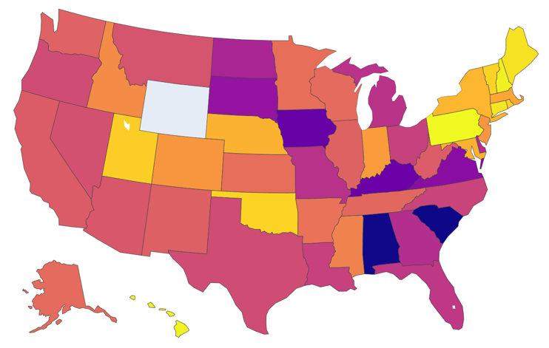
%Difference Between Private and In-State College ROI
Public ROI > Private ROI (p<0.05):
AL, CA, KY, MI, OH, SC, TX, VA
Private ROI > Public ROI (p<0.05):
PA
* 14 States with n<5 public or private schools excluded from statistical analysis
Both <5: AK, AX, DE, HI, ID, MT, NV, UT, WY
Public < 5: IA, NH, NM, ND, DC
Private<5: NM
Figure. Percent difference in 20yr ROI between Private and In-State Public colleges. %diff > 0% indicates Private ROI > Public ROI. [Equation: (Private-Public)/(avg ROI)*100]
Notes:
Total Count:
Private = 879
Public = 493

Slide 11
Salary Related to %STEM Majors at University
Early-Career
Pearson correlation, r = 0.59 (p<0.05)
Mid-Career
Pearson correlation, r = 0.60 (p<0.05)
Figure. Early- and mid-career salary as a function of percent of student body graduating with STEM bachelor degrees.

Slide 12
ROI by College Major

Slide 13
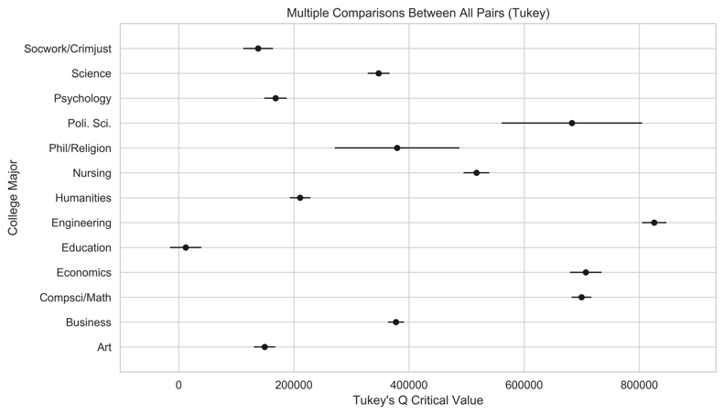
ROI by College Major
Tukey Post Hoc Results
Figure. Statistical results of ANOVA Tukey’s post hoc presented using Tukey’s Q critical value to compute interval width. Significant relationships are defined as intervals that do not overlap.

Slide 14
Figure. Estimated 20yr ROI per major for each private and public universities

Slide 15
Discussion
Graduates of 4yr colleges significantly out-earned their associate degree counterparts
Earning 17% more within 0-5yrs; increasing to 36% in year 5-10
Available data did not allow for 20yr ROI comparisons that would account for differences in education cost
Financial aid/grants subsidized as much as 11% of 4yr private colleges that would otherwise result in a negative ROI
Only 2% of 4yr public universities returned a negative ROI without financial aid
Attending a higher-priced 4yr private university may only be financially beneficial in the north-east corridor
Public universities in AL, CA, KY, MI, OH, SC, TX, VA significantly improved estimated ROI compared to private schools
Average early- and mid-career salaries of 4yr universities significantly correlated with %STEM of the graduating class
Results emphasize the high-paying careers within the STEM field
Significant differences between estimated ROI exist between college majors
Computer science, economics, and engineering majors had the highest estimated ROI of the majors
Differences between estimated ROI between private and public schools exist per major
No significant difference were observed for art, nursing, political science, and social work/criminal justice

Slide 16
Limitations
While I stand by the analysis, I question its validity

Slide 17
Limitations
Estimated ROI takes into consideration:
20yr median pay for a bachelor’s grad
24yr median pay for high school grad
Total 4yr cost of the university
Estimation incorrectly assumes the cost of the university is the list price; doesn’t account for interest
Typical repayment period for borrowers with $20k-$40k = 20yrs [11]
Personal Case Study:
Assuming I pay off my $100k in federal loan, at 8%, in 20yrs, the actual cost of my schooling is $200,600
This would dramatically change the ROI of college compared to high school graduates, or public university

Slide 18
References
https://www.forbes.com/sites/zackfriedman/2019/02/25/student-loan-debt-statistics-2019/#46e28a31133f
https://www.usatoday.com/story/money/2019/05/18/cost-of-college-the-year-you-were-born/39479153/
https://www.epi.org/publication/charting-wage-stagnation/
https://ktla.com/2020/01/16/university-of-california-wants-5-straight-years-of-annual-tuition-increases/
https://www.usatoday.com/story/college/2017/06/09/private-college-tuition-is-rising-faster-than-inflation-again/37432483/
https://www.cbpp.org/research/state-budget-and-tax/state-higher-education-funding-cuts-have-pushed-costs-to-students
https://flatironschool.com/blog/coding-bootcamps-vs-college
https://www.payscale.com/college-salary-report/best-schools-by-state
https://www.payscale.com/college-roi/state
https://www.payscale.com/college-roi/major
https://studentaid.gov/manage-loans/repayment/plans/standard#monthly-payments-consolidation

Slide 19
Questions?

Slide 20
Contact Information
LinkedIn
https://www.linkedin.com/in/jonharriseit
GitHub
https://github.com/jah377
ResearchGate
https://www.researchgate.net/profile/Jonathan_Harris23

